Slide 1

Calculus in Physics II
x axis
x₀ = 0
Knowing the car’s displacement history, find its velocity and acceleration.

Slide 2
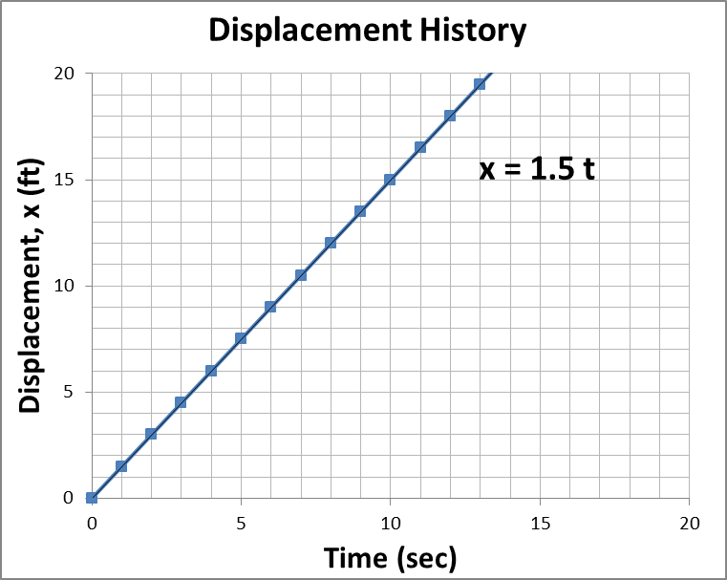
Given a displacement history, calculate the velocity history.
Average Velocity =
Δ Displacement
Total time
V =
Δx
Δt
x axis
x₀ = 0

Slide 3
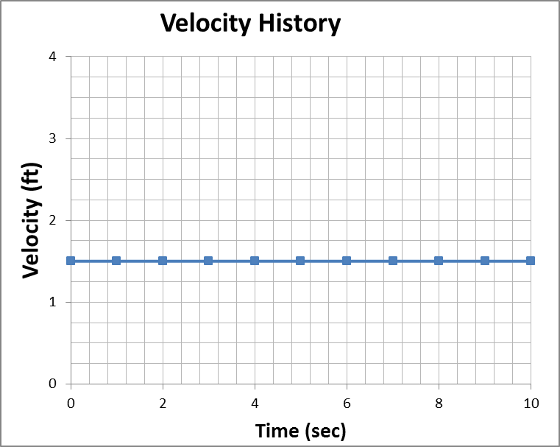
Given a displacement history, calculate the velocity history.
V =
Δx
= Slope
Δt
x axis
x₀ = 0

Slide 4
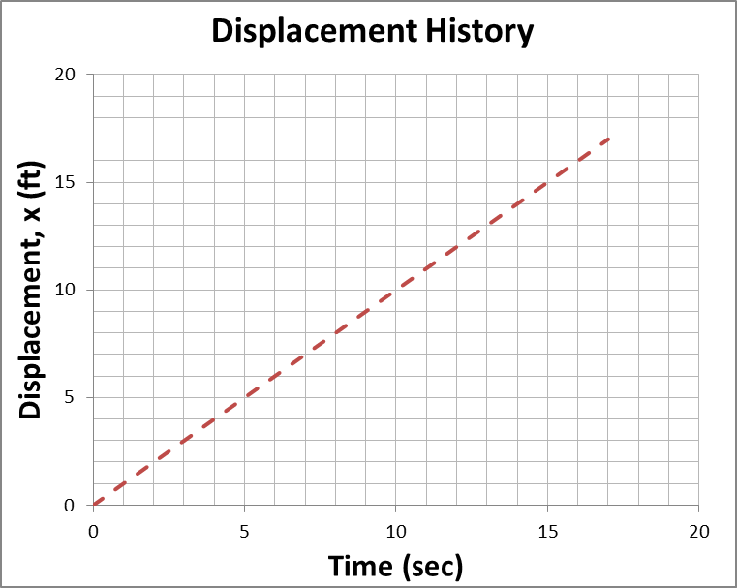
Given a displacement history, calculate the velocity history.
V =
Δx
= Slope
Δt
x axis
x₀ = 0

Slide 5
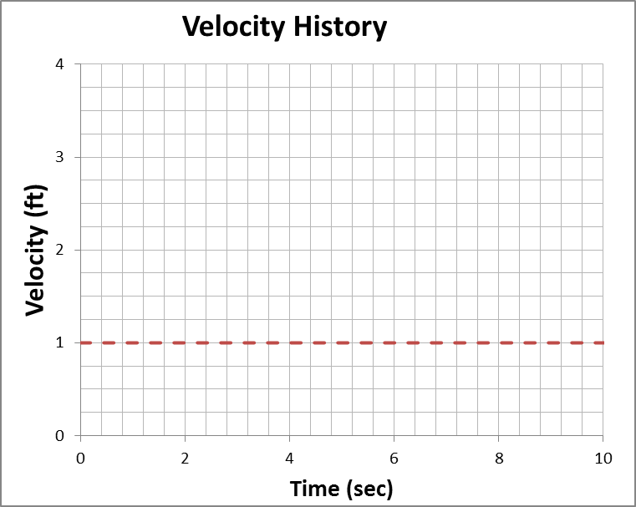
Given a displacement history, calculate the velocity history.
V =
Δx
= Slope
Δt
x axis
x₀ = 0

Slide 6
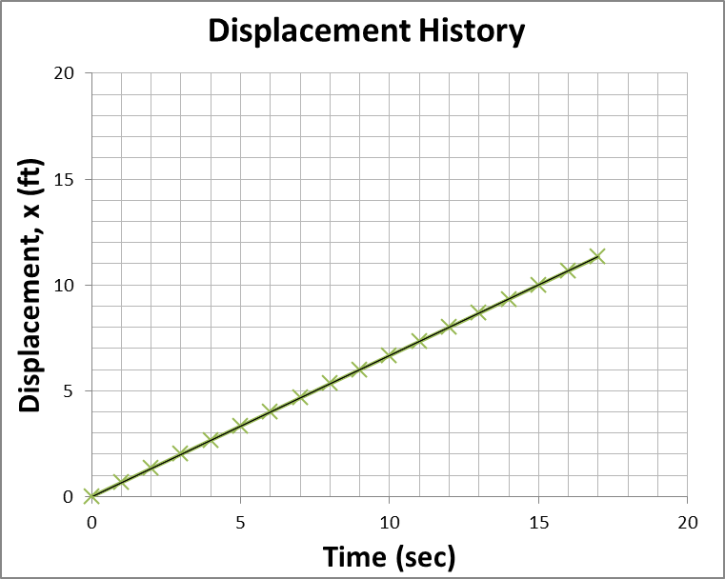
Given a displacement history, calculate the velocity history.
V =
Δx
= Slope
Δt
x axis
x₀ = 0

Slide 7
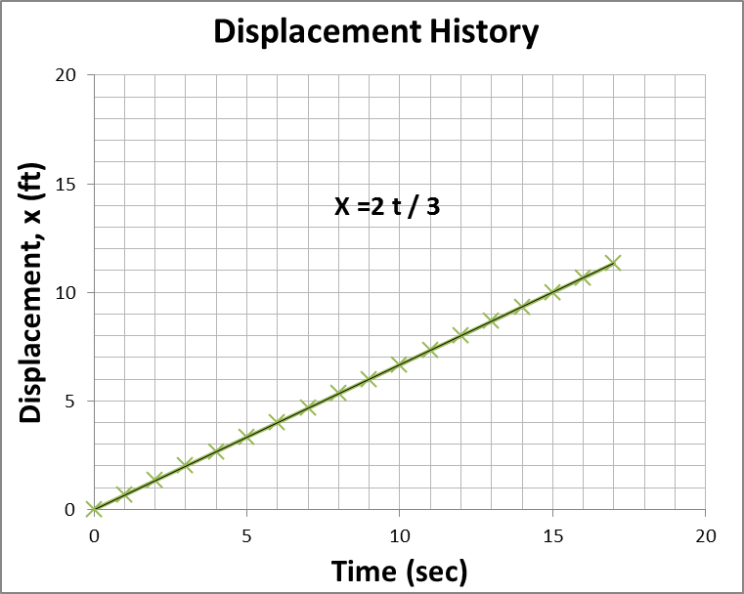
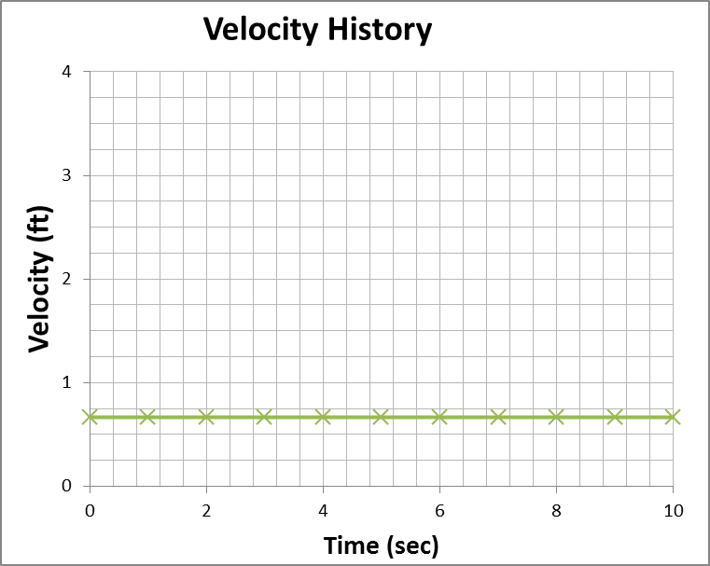
Given a displacement history, calculate the velocity history.
V =
Δx
= Slope
Δt
x axis
x₀ = 0

Slide 8
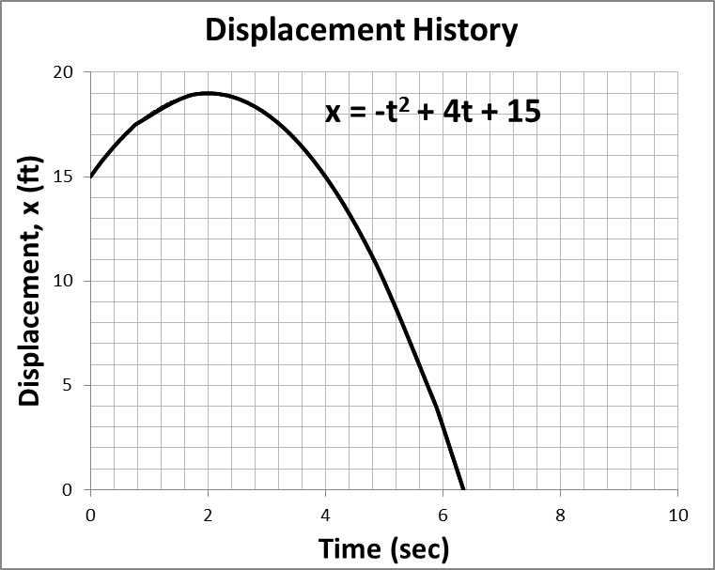
Given a displacement history, calculate the velocity history.
Slope constantly changing,
V changes in time!
approximately
V =
Δx
≈ Slope (if Δt small enough)
Δt
Find slope at time = 2.8 sec
x axis
x = 0
x₀ = 15

Slide 9
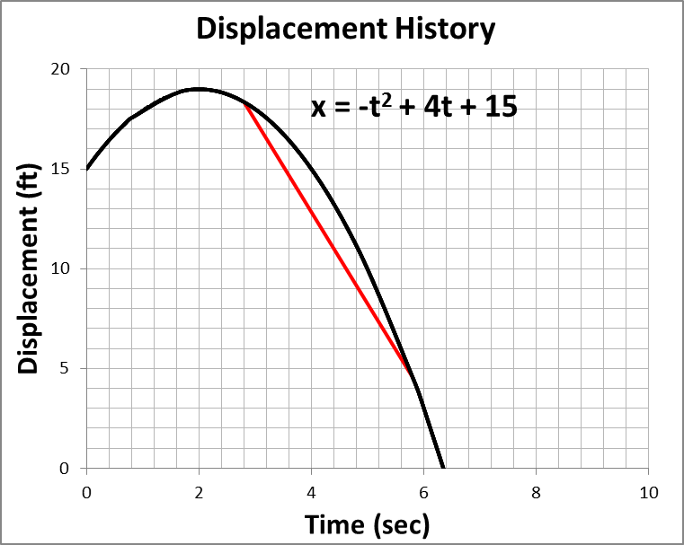
Given a displacement history, calculate the velocity history.
V =
Δx
≈ Slope
Δt
Find slope at time = 2.8 sec
x axis
x = 0
x₀ = 15

Slide 10
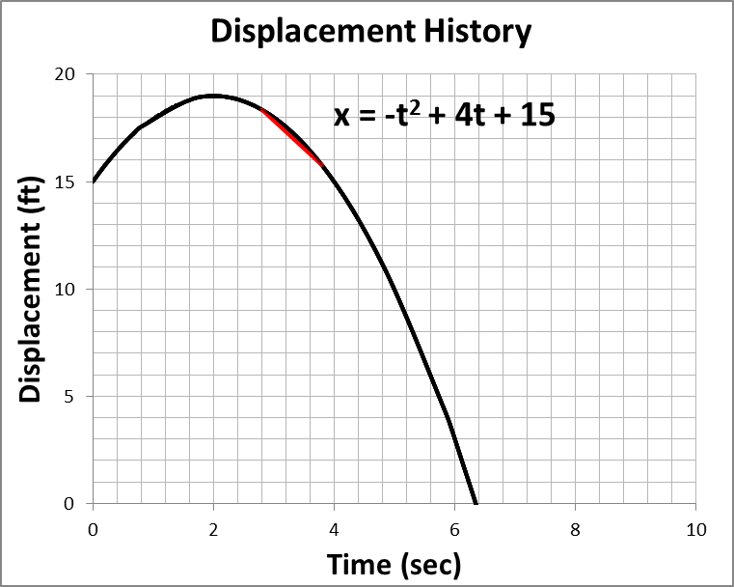
Given a displacement history, calculate the velocity history.
V =
Δx
≈ Slope
Δt
Find slope at time = 2.8 sec
x axis
x = 0
x₀ = 15

Slide 11
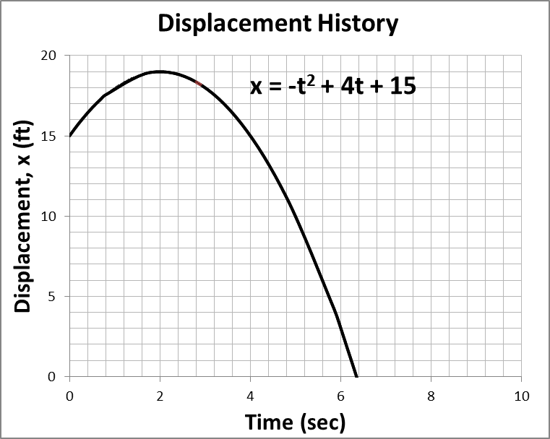
Given a displacement history, calculate the velocity history.
V =
Δx
≈ Slope
Δt
Find slope at time = 2.8 sec
Exact answer = -1.6
x axis
x = 0
x₀ = 15

Slide 12

Given a displacement history, calculate the velocity history.
V =
Δx
≈ Slope
Δt
Find slope at time = 2.8 sec
Exact answer = -1.6
V =
lim
Δx
= Slope =
dx
Δt→0
Δt
dt
Differential Calculus
x axis
x = 0
x₀ = 15

Slide 13
Differential Calculus for Physics
Power Rule
Given: x = a t^{b}; where a and b are constants.
dx
= ab t^{b-1}
dt
Given: y = a x^{b}; where a and b are constants.
dy
= ab x^{b-1}
dx

Slide 14
Find the derivative (dx/dt) ≡ Find the Velocity
x = 10 t²
x = 5 t³
x = 3
x = 3 t³ - 2 t² + 27
x axis
x = 0

Slide 15
Find the derivative (dy/dt) ≡ Find the Velocity
y = 10 t²
y = 3 t³
y = 6 t⁵
y = 2 t³ + 8 t² - 27
y axis
y = 0

Slide 16
Find the derivative (dy/dx):
y = 4 x²
y = 2 x³+ 2x +33
y = 6 x⁴
y = 8 x² + 8 x - 27

Slide 17
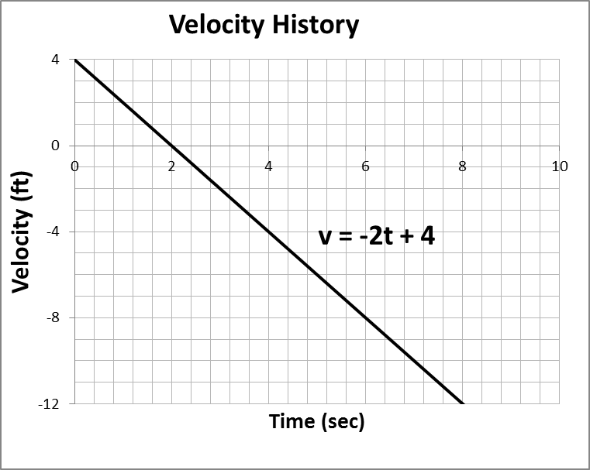
Use calculus to find the velocity at 2.8 sec.
x = a t^{b}
x = - t² +4 t + 15
dx
= v = -2 t +4
dt
dx
(t = 2.8) = v = -2(2.8)+4
dt
dx
ft
(t = 2.8) = -1.6
dt
sec

Slide 18
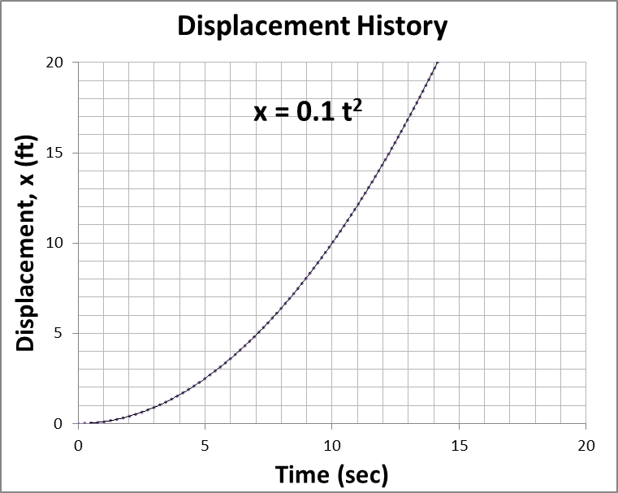
Use calculus to find the velocity at 10. sec.
V =
lim
Δx
= Slope =
dx
Δt→0
Δt
dt
Slope constantly changing,
V changes in time!
x axis
x₀ = 0

Slide 19
Given a displacement history, calculate the velocity history.
V =
lim
Δx
= Slope =
dx
Δt→0
Δt
dt
Find velocity at 10. sec
x = 0.1 t²
dx
= v = 0.2 t
dt
dx
ft
(t = 10) = 2
dt
sec
x axis
x₀ = 0

Slide 20
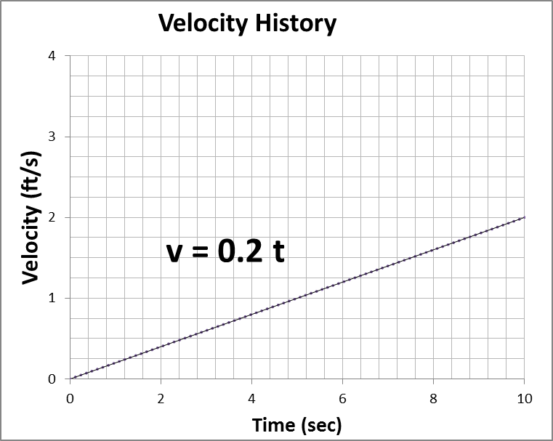
If the displacement is a parabola, the velocity is linear.
If the velocity is increasing what does that say about the acceleration?
Average acceleration=
Δ Velocity
Total time
a =
Δv
Δt
lim
Δv
dv
a =
= Slope of velocity =
Δt→0
Δt
dt

Slide 21
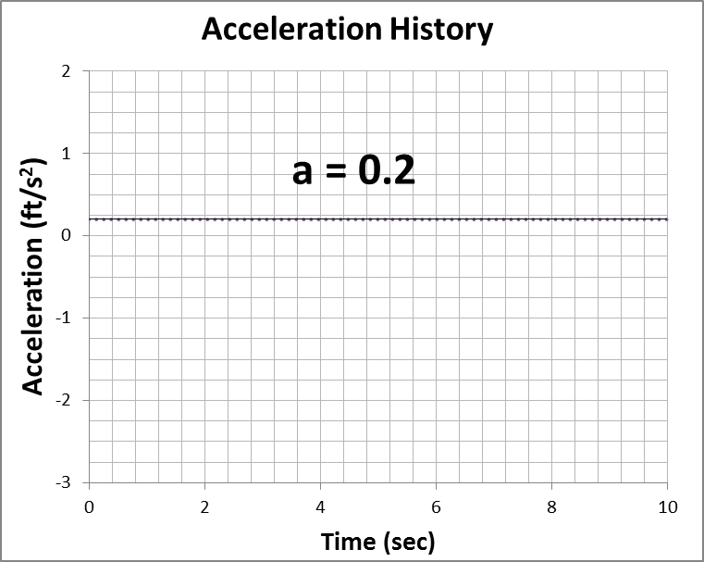
Given a velocity history, calculate the acceleration history.
lim
Δv
dv
a =
= Slope of velocity =
Δt→0
Δt
dt
v = 0.2 t
dv
ft
a =
= 0.2
dt
sec²

Slide 22
Find the derivative (dv/dt) ≡ Find the Acceleration
v = 20 t
v = 15 t²
v = 0
v = 9 t² - 4 t
x axis
x = 0

Slide 23
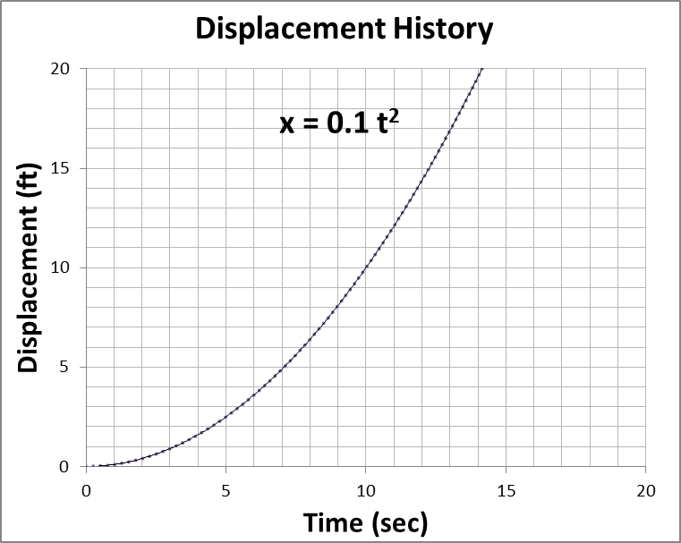
Given a displacement history, calculate the acceleration.
x = 0.1 t²
dx
= v = 0.2 t
dt
dv
d
dx
d²x
ft
a =
=
=
= 0.2
dt
dt
dt
dt²
sec²
Find acceleration at 10. sec
Find acceleration at 20. sec

Slide 24
Find second derivative (d²x/dt²) (i.e., acceleration):
x = 10 t²
x = 5 t³
x = 3
x = 3 t³ - 2 t² + 27

Slide 25
Find second derivative (d²y/dt²) (i.e., acceleration):
y = 10 t²
y = 3 t³
y = 6 t⁵
y = 2 t³ + 8 t² - 27

Slide 26
Find second derivative (d²y/dx²):
y = 4 x²
y = 2 x³+ 2x +33
y = 6 x⁴
y = 8 x² + 8 x - 27

Slide 27
Summary of Definitions
dx
v =
dt
dv
a =
dt
dv
d
dx
d²x
a =
=
=
dt
dt
dt
dt²

Slide 28
Calculus in Physics II
x axis
x₀ = 0
Knowing the car’s velocity history, find its displacement.
We will be working the earlier problems in reverse; integration is the inverse operation of differentiation.

Slide 29
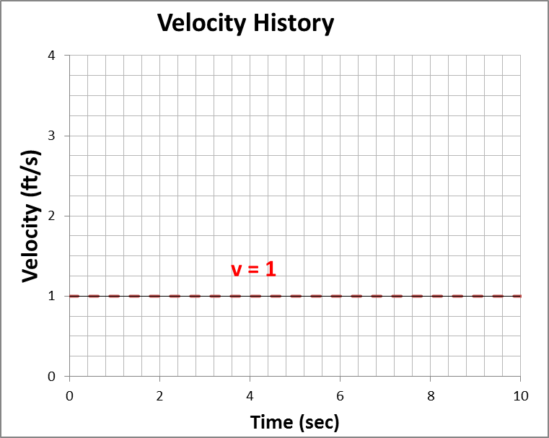
Given a velocity history, calculate the displacement history.
Know:
Average Velocity =
Δ Displacement
Total time
v =
Δx
Δt
Therefore:
Δx = v
Δt
x axis
x₀ = 0

Slide 30
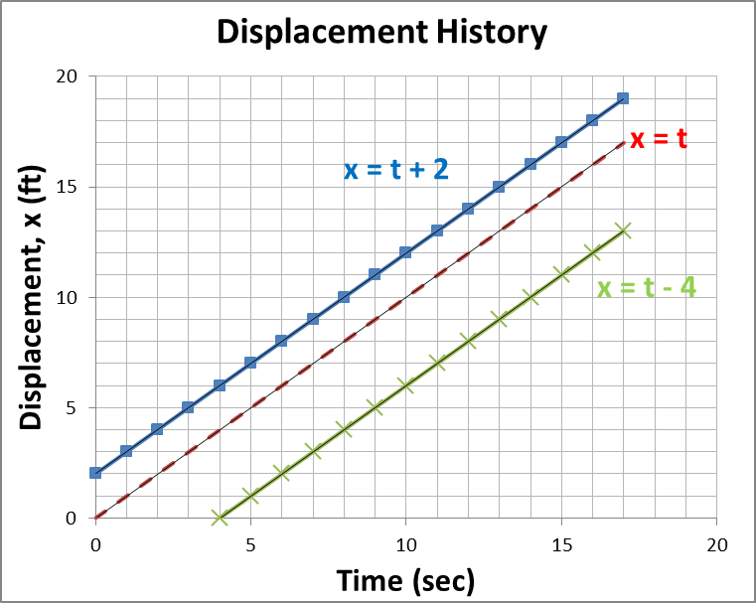
Check out these possible solutions.
V =
lim
Δx
= Slope =
dx
Δt→0
Δt
dt
Which curve satisfies the above definition of velocity to produce a velocity = 1?
All of them!
x axis
x₀ = 0

Slide 31
Given a velocity history, calculate the displacement at t = 2 sec.
V =
Δx
Δt
Δx = v
Δt
v = (1 ft/s) (2 s) = 2 ft
The area under the curve!
x axis
x₀ = 0

Slide 32
Possible solutions.
Which curve has a displacement of 2 ft at 2 sec?
x = t
x axis
x₀ = 0

Slide 33
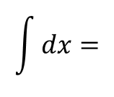
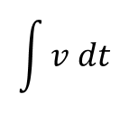
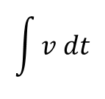
Given a velocity history, calculate the displacement at t = 2 sec.
Area under velocity curve is the displacement.
Δx = v
Δt
Sum all the areas is integral calculus.
Δt = dt
dx = v
dt
$$\int{dx}=$$
$$\int{v dt}$$
$$\int{v dt}$$
x =
x axis
x₀ = 0

Slide 34
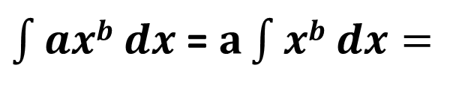
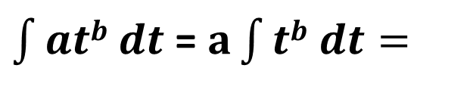
Integral Calculus for Physics
Reverse Power Rule
at^{(b+1)}
$\int{atb dt}$ = $a\int{tb dt=}$
+ C
(b+1)
ax^{(b+1)}
$\int{axb dx}$ = $a\int{xb dx=}$
+ C
(b+1)

Slide 35
Find the integrals of the following ≡ Find the displacement
v = 20 t
x = 10 t² + C
v = 15 t²
x = 5 t³ + C
v = 0
x = C
v = 9 t² - 4 t
x = 3 t³ - 2 t² + C
v = 2
x = 2t + C
x axis
x = 0

Slide 36
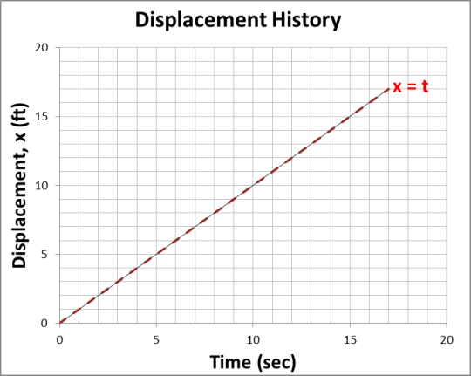
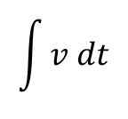
Given a velocity history, displacement = 0 at start, calculate the displacement history.
$$\int{v dt}$$
x =
Given: v = 1
x = t + x₀
The initial displacement at t = 0 was zero; therefore, x₀ = 0
x = t
Δt = dt
x axis
x₀ = 0

Slide 37

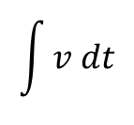
Given a velocity history, and knowing that the initial displacement was 0 (X₀ = 0), calculate the displacement history.
$$\int{v dt}$$
x =
Given: v = 0.2 t
x = 0.1 t² + x₀
The initial displacement (x₀) at t = 0 was zero; therefore, x₀ = 0
x = 0.1 t²
x axis
x₀ = 0

Slide 38

Verify that the area under the velocity curve is the displacement.
$$\int{v dt}$$
x =
x (6 sec) = 0.5 (6 sec) (1.2 ft/sec)
X (6 sec) = 3.6 ft
(6 sec, 3.6 ft)

Slide 39
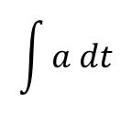
Given an acceleration history, find the velocity history.
Define:
Average Acceleration=
Δ Velocity
Total time
a =
Δv
Δt
Therefore:
Δv = a
Δt
dv = a dt
$$\int{a dt}$$
v =
x axis
v₀ = 0

Slide 40
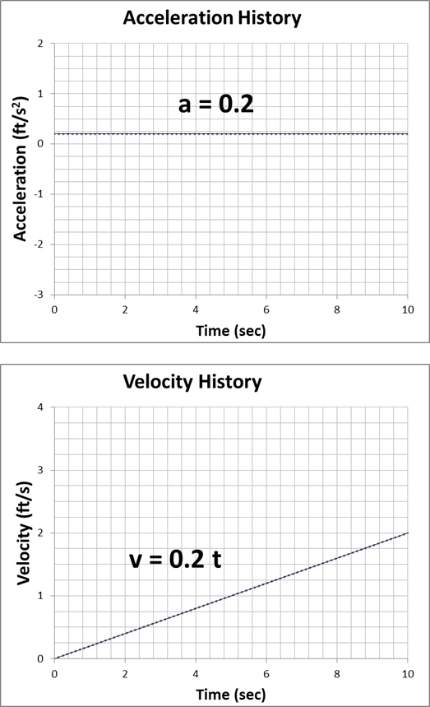
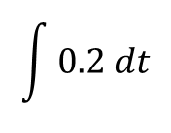
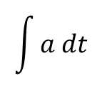
Given an acceleration history, and knowing that the initial velocity was 0 (v₀ = 0), calculate the velocity history.
$$\int{a dt}$$
v =
Given: a = 0.2
$$\int{0.2 dt}$$
v =
= 0.2 t + v₀
At t = 0, v = 0; therefore, v₀ = 0.
v = 0.2 t
x axis
v₀ = 0

Slide 41
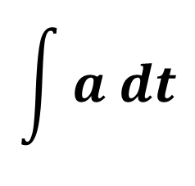
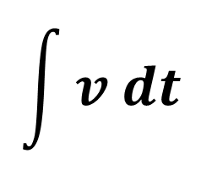
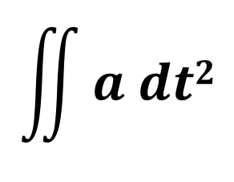
Summary of Definitions
$$\int{v dt}$$
dx
v =
x =
dt
$$\int{a dt}$$
dv
a =
v =
dt
dv
d
dx
d²x
$$\iint{a dt2}$$
a =
=
=
x =
dt
dt
dt
dt²

Slide 42
Constant acceleration (gravity)
d²x
a = -g
= -g
dt²
dx
v =
= -g t + v₀
dt
v₀ = v
x₀ = 0
-g t²
x =
+ v₀t + x₀
2
The hardest problem will be to solve two simultaneous equations.

