Slide 1
Engineering Principle #1: Neutral Buoyancy & Stability
Weight (W) – Measure of the gravitational force on an object (not submerged)
W
Buoyancy (B) - Upward force exerted by a liquid on an immersed or floating object.
B
Neutrally Buoyant - An object that will neither sink nor float. W = B
B
W = B
W
Center of Buoyancy (CB) – Center of gravity of the displaced fluid.
Float
Center of Gravity (CG) – Point where the weight of the entire body can be considered to act.
Weight
Design Goal: Nearly Neutrally Buoyant with CB above CG.

Slide 2
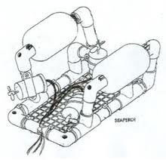
Engineering Principle #2: Propulsion
Thrust (T) – Force that moves an object.
T
Friction (R) – Resistance to motion. (Tape, wax, plastic container, warping due to heat)
Revolutions per minute (rpm) – Number of turns in a minute.
Motor part number 232022:
No load: 12500 rpm
Max efficiency: 9820 rmp.
Construction Goal: RMP before construction = RMP after construction.
Design Goal: Undisturbed flow to propeller
T

Slide 3
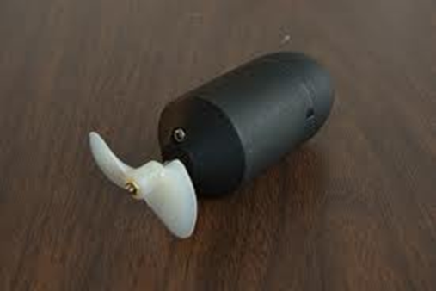
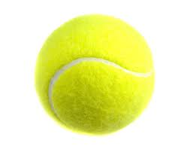
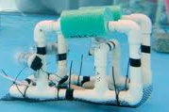
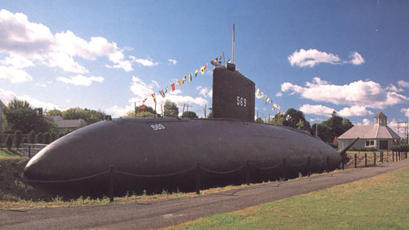
Engineering Principle #3: Drag
Drag (D) – Resistance of motion through a medium.
T
Standard
Improved
Drag (D) = (Drag Coefficient) (Area) (Velocity)²
USS Albacore (AGSS 569)
Design Goal: Minimize Drag

Slide 4
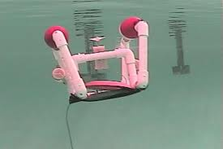
Engineering Principle #4: Maneuverability
A. Turns (usually 2 motors)
Standard
Improved
B. Dive/Surface (usually 1 motor)
For maneuverability with a single motor, it must be located near the midpoint of the line between the CG and CB.
T
Design Goal: Match degree of maneuverability with mission.

Slide 5
Engineering Principle #5: Motion (Newton 2nd L:aw)
F_{net} = (Mass)_{total} (Acceleration)
Mass – The amount of material.
Acceleration – Rate of change of velocity.
F_{net} = Thrust (T) – Drag (D)
(Mass)_{total} = Mass of vehicle plus added mass of water moving with vehicle.
F _{net}
Design Goal: Maximize acceleration (Minimize total mass) while ensuring stability.

Slide 6
Engineering Design Flowchart
Identify Problem
Identify criteria & constraints
Brainstorm solutions
Select an approach
Build prototype
Test
Yes
Modify?
No
Done

